Slide 1
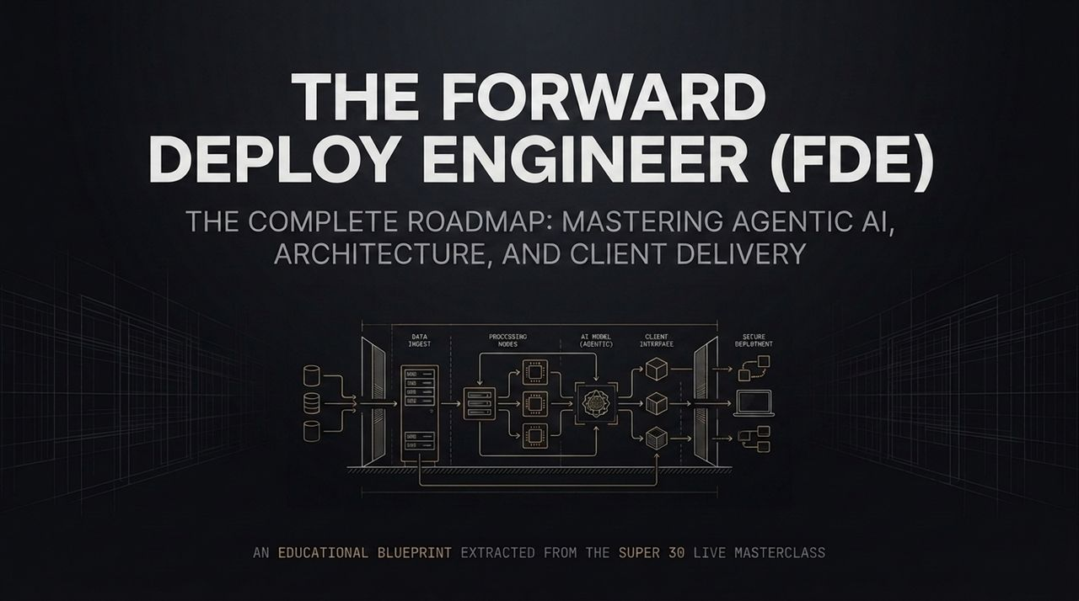
Notes:
Welcome, everyone. Today, we are diving deep into one of the most critical evolutions in modern tech architecture and engineering: The Forward Deployment Engineer (FDE) Blueprint.
If you've been following industry trends over the last year, you’ve probably noticed every major enterprise, technology influencer, and startup founder talking about the FDE role. But what actually is a Forward Deployment Engineer? Is it just hype, or is it a fundamental shift in how enterprise software is built and delivered?
As we can see from our foundational architecture diagram here, an FDE is an end-to-end technical leader. They don't just sit in a silo writing isolated code. They bridge the entire pipeline—from ingesting complex enterprise data, through processing nodes and agentic AI models, to client interfaces and secure enterprise deployment.
This blueprint is extracted directly from our Super 30 Live Masterclass. Over the next 16 slides, we are going to dissect the technical stack, the client delivery lifecycle, unit economics, security frameworks, and the exact steps required to transform into a high-impact FDE. By the end of this session, you will understand how to transition from traditional multi-month development pipelines to delivering production-ready, agentic AI solutions in days. Let’s get started.
https://www.youtube.com/watch?v=dASmzI2A_tY

Slide 2
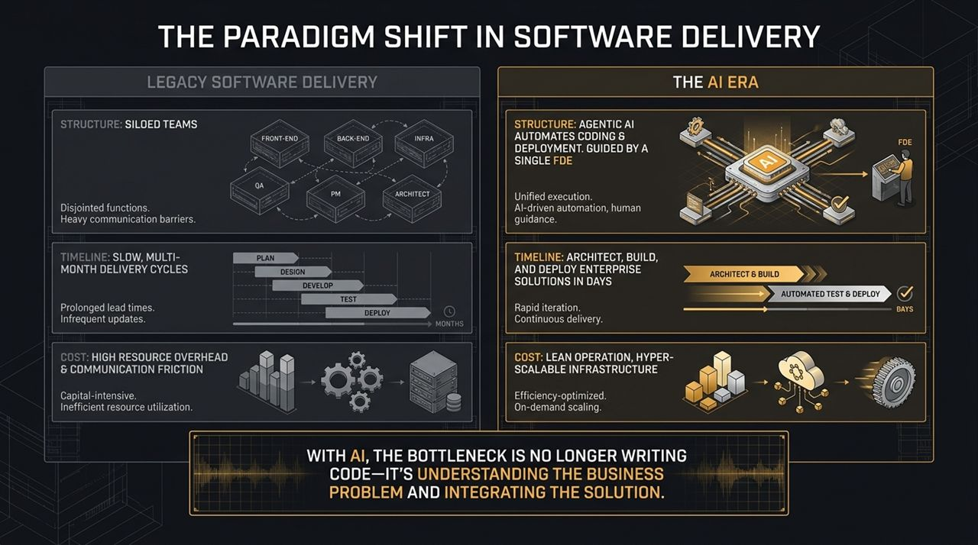
Notes:
To understand why the FDE is in such high demand, we first need to look at the massive paradigm shift currently happening in software delivery.
On the left, we have Legacy Software Delivery. Historically, building an enterprise solution meant coordinating a massive, siloed team: separate front-end engineers, back-end engineers, infrastructure engineers, QA testers, project managers, and solution architects. What happens when you have seven different teams? Communication friction, heavy hand-offs, and endless alignment meetings. The timeline to plan, design, develop, test, and deploy a feature dragged on for months. This model is extremely capital-intensive and slow to react to business needs.
Now, look at the right side: The AI Era. Agentic AI tools and vibe coding frameworks now automate significant portions of boilerplate coding, testing, and infrastructure deployment. In our last live coding session, we demonstrated building a full application and orchestrating automated deployment via Terraform in under three hours!
Because AI accelerates execution, the primary bottleneck in software delivery is no longer writing code—it is understanding the business problem and integrating the technical solution.
With an FDE steering agentic workflows, a single engineer can architect, build, and deploy an enterprise solution in days rather than months. We move from heavy overhead to lean operations with hyper-scalable infrastructure.

Slide 3
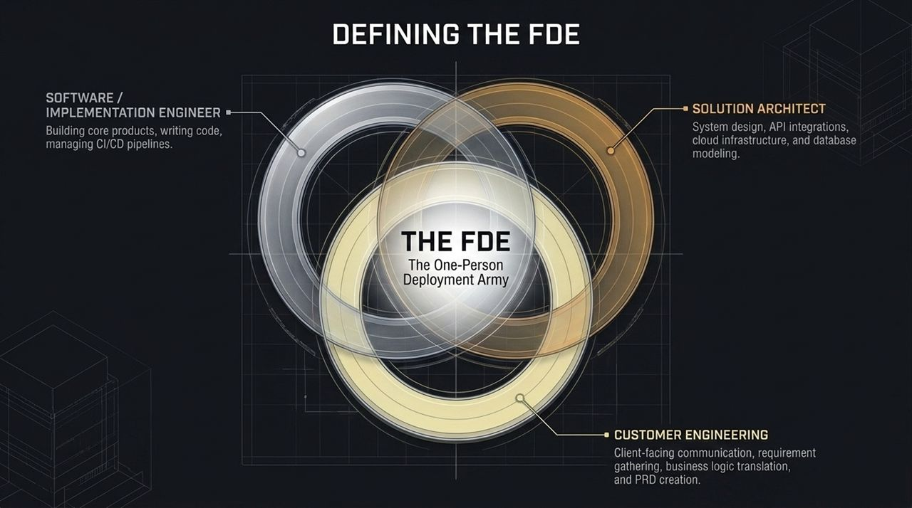
Notes:
People often ask me: 'Does an FDE replace existing roles, or is it a combination of them?' The answer is that an FDE operates as a 'One-Person Deployment Army' by sitting at the exact intersection of three core technical disciplines.
Software / Implementation Engineer: At the foundational level, an FDE understands how to write production code, integrate APIs, manage CI/CD pipelines, and build core products.
Solution Architect: An FDE understands system design. They know how to design database schemas—whether SQL, NoSQL, Vector, or Graph—map out cloud infrastructure on AWS/GCP/Azure, and handle secure API protocols.
Customer Engineering: This is what truly separates a traditional developer from an FDE. An FDE can sit across the table from a client, founder, or enterprise stakeholder, conduct discovery, extract raw business pain points, and translate them directly into technical requirements and a Product Requirements Document (PRD).
When you combine client-facing domain expertise with architectural mastery and AI-assisted implementation speed, you eliminate the communication latency between product, sales, and engineering. That is why a single FDE can deliver what previously required a team of ten.

Slide 4
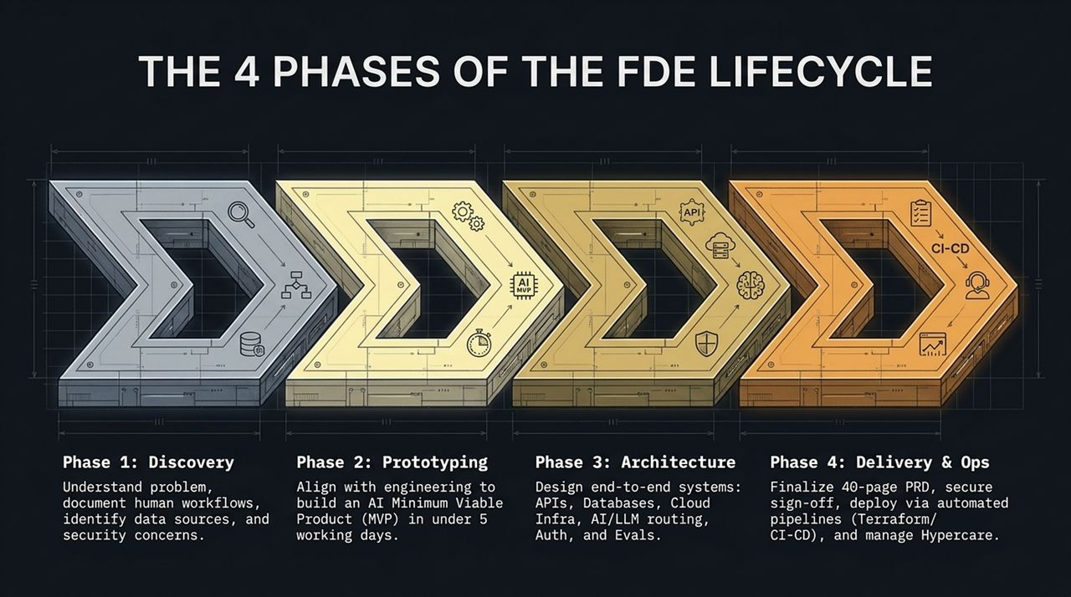
Notes:
How does an FDE manage a project from initial client conversation to production rollout? We break this down into The 4 Phases of the FDE Lifecycle:
Phase 1: Discovery. Before touching a line of code, the FDE maps out the existing manual human workflows, identifies enterprise data sources (like SAP, Salesforce, or internal databases), defines scale targets, and surfaces strict compliance/security requirements.
Phase 2: Prototyping (MVP). In the AI era, proof-of-concept shouldn't take two months. An FDE leverages agentic AI to build a working AI Minimum Viable Product (MVP) in under 5 working days to validate core feasibility.
Phase 3: Architecture. Once the prototype is validated, the FDE designs the scalable end-to-end system: establishing REST/gRPC endpoints, database layers, cloud infrastructure, LLM routing, role-based access control, and evaluation pipelines.
Phase 4: Delivery & Ops. The FDE formalizes a comprehensive 40-page PRD, secures client sign-off, provisions production infrastructure automatically using Infrastructure-as-Code (Terraform), and oversees the Hypercare transition period.
This structured cadence ensures speed without sacrificing enterprise stability or security.

Slide 5
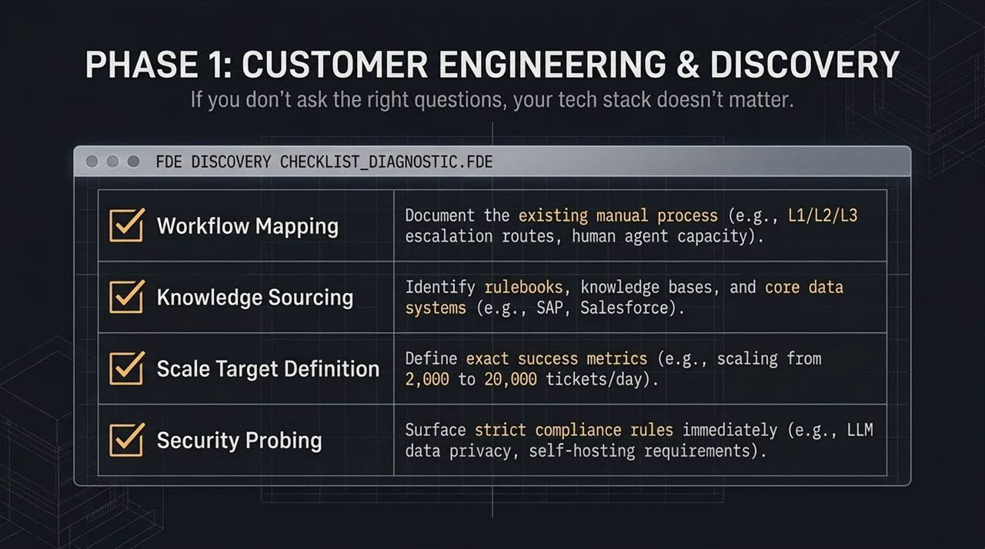
Notes:
Let's zoom into Phase 1: Discovery. Remember this rule: If you don't ask the right questions, your tech stack doesn't matter.
When meeting with enterprise clients, an FDE uses the Discovery Diagnostic Checklist to audit the client's current ecosystem across four crucial dimensions:
Workflow Mapping: Document the human operational workflow end-to-end. For example, in a customer service desk, how are L1, L2, and L3 tickets currently routed? Where are the manual bottlenecks?
Knowledge Sourcing: Identify where the business truth lives. Is it in unstructured rulebooks, SAP, Salesforce, or legacy SQL databases? What access controls exist around this data?
Scale Target Definition: Define exact success metrics up front. Don't accept vague goals like 'make it faster'. Define metrics like: 'We need to scale from handling 2,000 tickets/day to 20,000 tickets/day without increasing headcount.'
Security Probing: Surface strict compliance rules immediately. Can data leave their Virtual Private Cloud (VPC)? Are they bound by HIPAA, GDPR, or industry regulations requiring self-hosted LLMs?
If you skip security and scale probing in Phase 1, your architecture will fail in Phase 3.

Slide 6
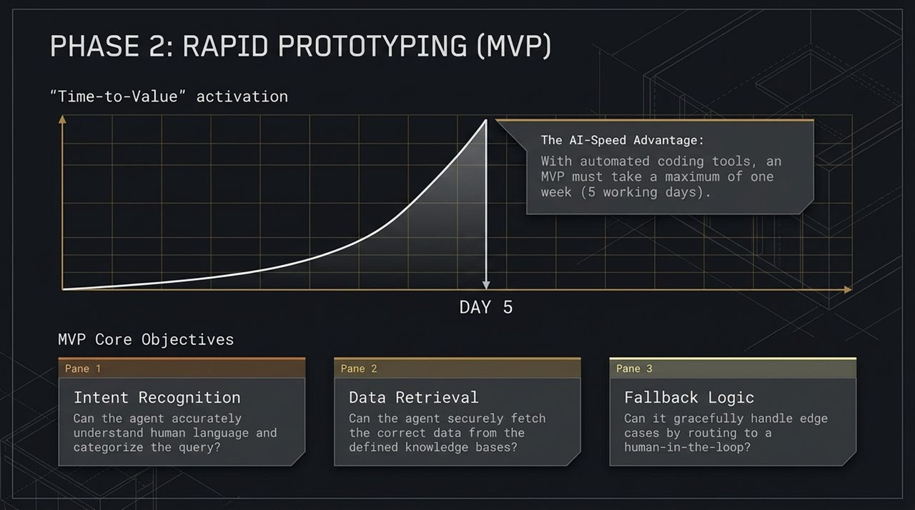
Notes:
Moving to Phase 2: Rapid Prototyping. In enterprise sales, 'Time-to-Value' is everything. The faster a client sees a functional demo operating on their context, the faster you build trust.
With modern automated coding tools, an MVP must take a maximum of 5 working days.
During this 5-day cycle, the FDE focuses on validating Three Core MVP Objectives:
Pane 1: Intent Recognition. Can the AI agent accurately interpret complex human language queries and categorize the underlying request correctly?
Pane 2: Data Retrieval. Can the agent securely fetch contextually accurate data from knowledge bases or enterprise APIs without hallucinating?
Pane 3: Fallback Logic. No AI model is 100% perfect. Does the system gracefully catch low-confidence queries or edge cases and hand them off to a human-in-the-loop seamless escalation route?
Achieving these three objectives within 5 days proves technical viability to stakeholders before committing major budget to production rollout.

Slide 7
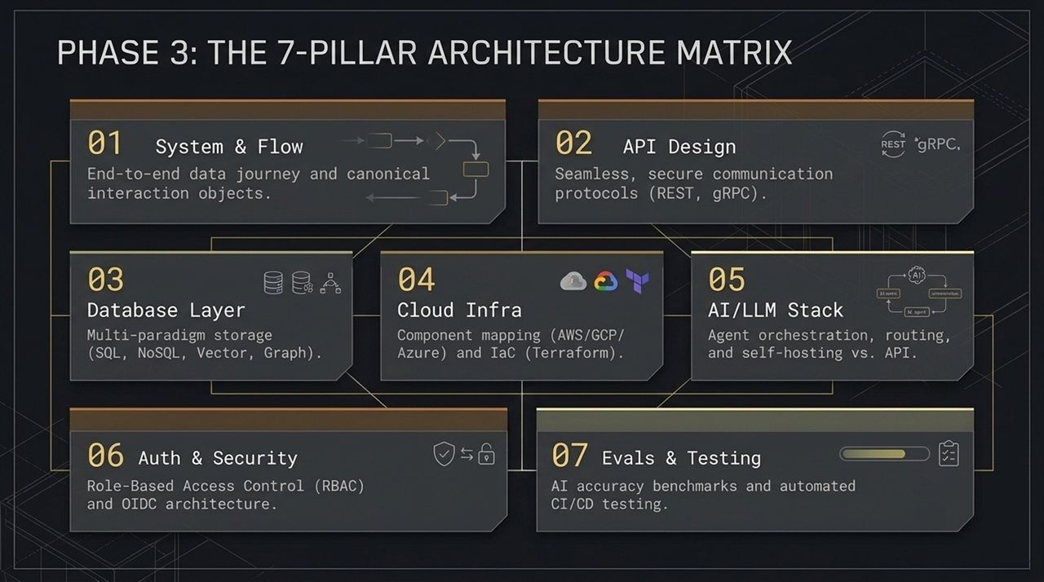
Notes:
When transitioning from an MVP to a full production deployment, an FDE relies on The 7-Pillar Architecture Matrix. This is the master checklist for enterprise durability:
System & Flow: Mapping the end-to-end data journey and standardizing canonical interaction objects across services.
API Design: Designing secure, performant communication protocols using REST for external client interfaces and gRPC for low-latency internal microservice communication.
Database Layer: Architecting multi-paradigm storage—combining relational SQL databases, document-based NoSQL, high-dimensional Vector databases for RAG, and Graph databases for complex entity relationships.
Cloud Infra: Component mapping across AWS, GCP, or Azure, and codifying the entire setup using Infrastructure-as-Code tools like Terraform.
AI/LLM Stack: Managing agent orchestration, routing models based on query complexity, and balancing self-hosted open models vs. proprietary external APIs.
Auth & Security: Implementing enterprise-grade Role-Based Access Control (RBAC) and OpenID Connect (OIDC) authentication.
Evals & Testing: Establishing continuous LLM evaluation benchmarks and automated CI/CD unit/integration testing pipelines.

Slide 8
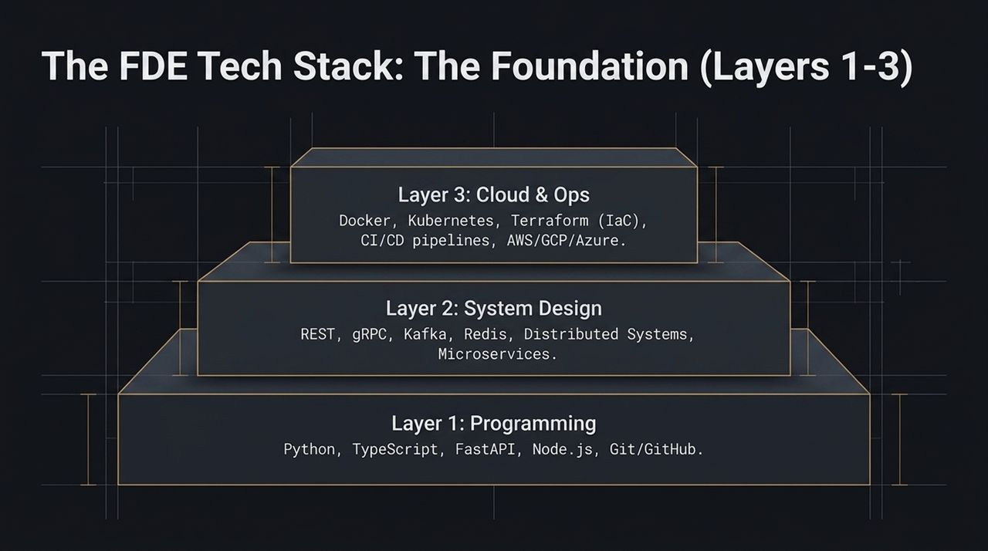
Notes:
To execute on the 7-Pillar Architecture, an FDE must be grounded in a solid technical foundation. We structure the tech stack across six layers, starting with Layers 1 through 3:
Layer 1: Programming Foundation. Python and TypeScript are non-negotiable. FastAPI and Node.js form the foundation for lightweight, high-concurrency web services, backed by strict version control practices using Git and GitHub.
Layer 2: System Design. An FDE must understand microservices architecture, REST and gRPC protocols, event-driven streaming with Apache Kafka, and high-performance caching layers using Redis to handle distributed workloads.
Layer 3: Cloud & Ops. Modern deployment relies on containerization with Docker and orchestration via Kubernetes. Crucially, infrastructure must be defined declaratively using Terraform, enabling automated, reproducible deployments across AWS, GCP, or Azure through automated CI/CD pipelines.

Slide 9
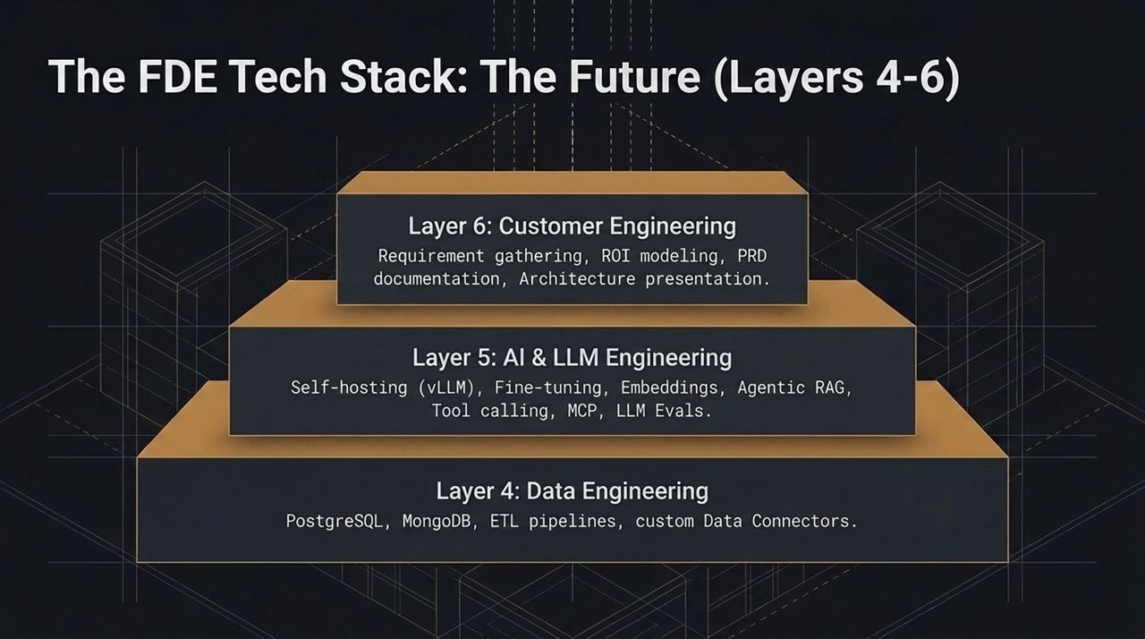
Notes:
Now let's examine the top three layers—Layers 4 through 6—which represent the modern edge of AI engineering and business strategy:
Layer 4: Data Engineering. Enterprise AI is only as good as the underlying data pipelines. FDEs manage structured data in PostgreSQL, unstructured data in MongoDB, build robust ETL pipelines, and construct custom data connectors for enterprise platforms.
Layer 5: AI & LLM Engineering. This layer covers advanced agentic capabilities: self-hosting models with high-throughput engines like vLLM, fine-tuning, vector embeddings, Agentic RAG, function tool calling, Model Context Protocol (MCP), and automated LLM evaluations.
Layer 6: Customer Engineering. The topmost layer links tech back to business value. It encompasses requirement gathering, quantitative ROI modeling, formal PRD authoring, and presenting complex technical architecture clearly to executive board members.

Slide 10
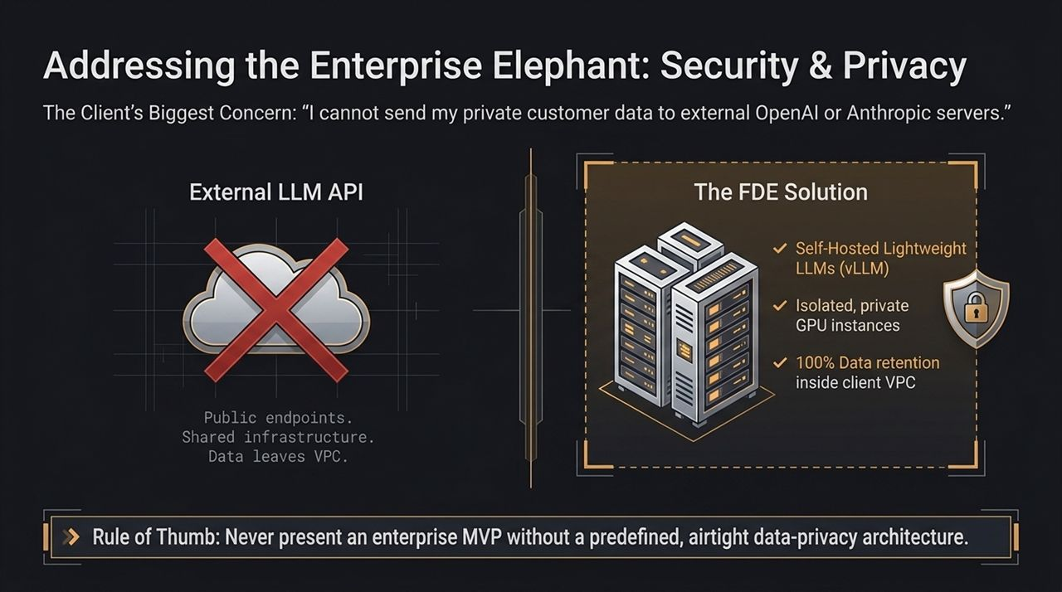
Notes:
If you speak to enterprise CTOs or Chief Risk Officers, you will encounter the exact same roadblock: 'We cannot send our confidential customer data or internal IP to external, third-party OpenAI or Anthropic public endpoints.'
Public API endpoints run on shared infrastructure, raising data retention, privacy, and regulatory compliance risks.
The FDE Solution: An FDE designs airtight data-privacy architectures. Instead of relying exclusively on public cloud APIs, FDEs deploy lightweight, highly capable open-weights LLMs using serving frameworks like vLLM directly onto isolated, private GPU instances inside the client’s own Virtual Private Cloud (VPC).
This guarantees 100% data retention inside the client's secure perimeter.
Golden Rule: Never present an enterprise AI solution without a pre-defined, secure data-privacy architecture.

Slide 11
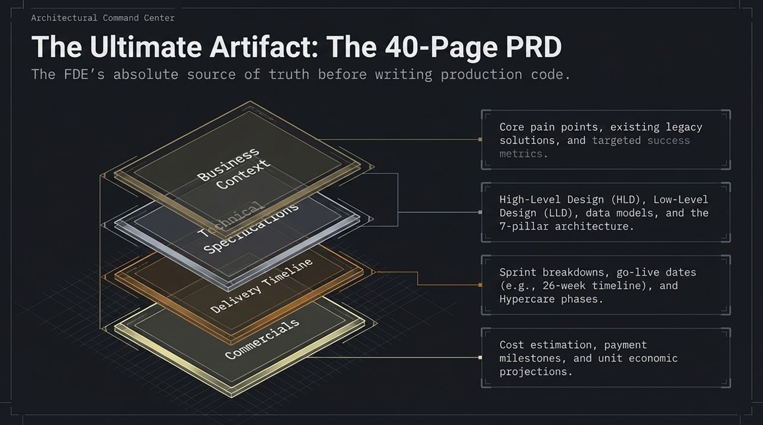
Notes:
Before an FDE writes production code for an enterprise system, they establish the single source of truth: The 40-Page Product Requirements Document (PRD).
This document bridges business stakeholders and engineering execution across four mandatory sections:
Business Context: Outlining core operational pain points, legacy software constraints, baseline metrics, and targeted success KPIs.
Technical Specifications: Containing the High-Level Design (HLD), Low-Level Design (LLD), database ER diagrams, API schemas, and the 7-Pillar Architecture Matrix.
Delivery Timeline: Clear sprint breakdowns, go-live target dates (such as a 26-week enterprise rollout schedule), and post-deployment Hypercare support protocols.
Commercials: Financial cost estimations, infrastructure expenses, implementation payment milestones, and unit economic projections.
With a thorough PRD, there is zero ambiguity during implementation.

Slide 12
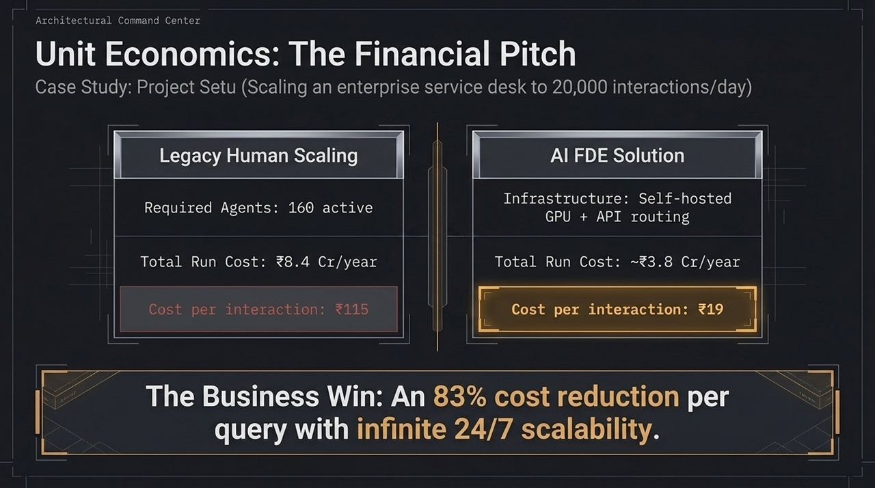
Notes:
To convince enterprise executives, you must speak their language: Unit Economics and ROI. Let's walk through an actual case study—Project Setu—scaling an enterprise service desk to handle 20,000 interactions per day.
Legacy Human Scaling: To manually handle 20,000 daily tickets, the client required 160 active support agents. At scale, this resulted in an annual operating cost of ₹8.4 Crore/year, bringing the cost per interaction to roughly ₹115 per ticket.
AI FDE Solution: The FDE re-architected the service desk using self-hosted GPU infrastructure combined with intelligent API routing. The annual operational run cost dropped to ~₹3.8 Crore/year, reducing the cost per interaction to just ₹19 per ticket.
The Business Win: An 83% cost reduction per interaction alongside instantaneous 24/7 scalability. This financial model makes adopting the solution an obvious decision for executive teams.

Slide 13
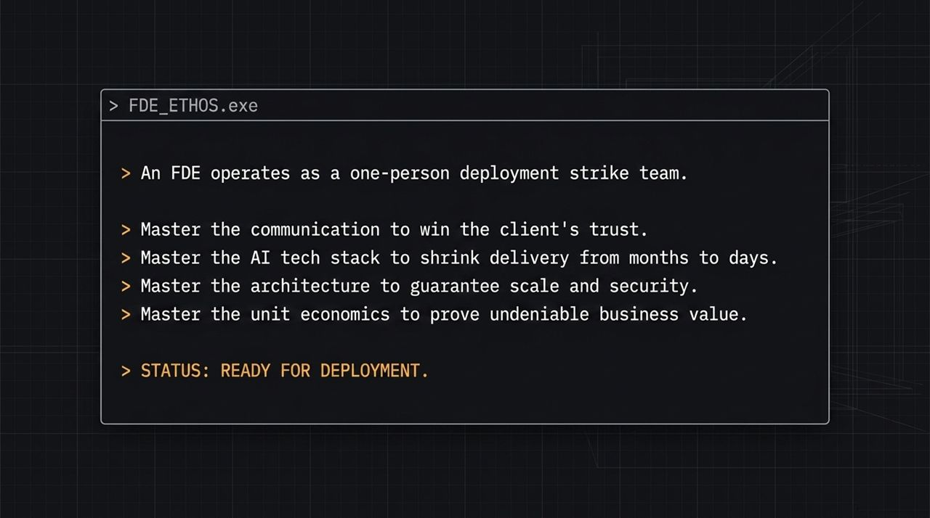
Notes:
To wrap up our tactical mindset, let's review the core FDE Ethos:
An FDE operates as a one-person deployment strike team.
Master Communication to win client trust and extract real requirements.
Master the AI Tech Stack to shrink delivery cycles from multi-month projects to days.
Master System Architecture to guarantee enterprise scale, reliability, and data security.
Master Unit Economics to provide undeniable financial value to business stakeholders.
When you align technical mastery with business acumen, you become an indispensable engineering asset in the AI era.

Slide 14
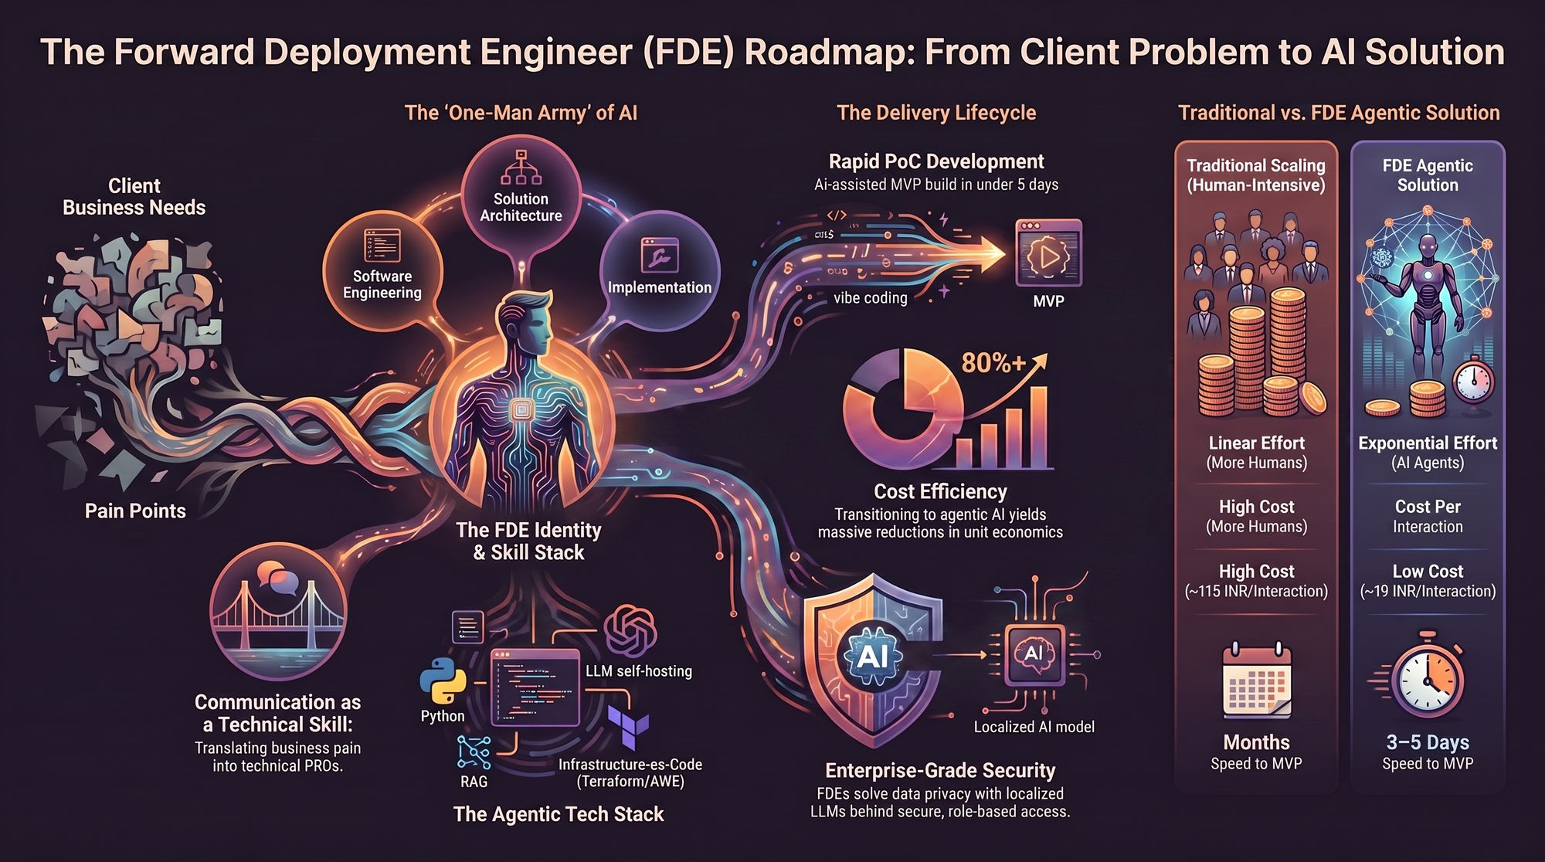
Notes:
Slide 14 provides a visual comparison contrasting traditional delivery models against the FDE Agentic model:
Effort & Scalability: Traditional scaling requires linear effort—adding more human agents as ticket volume grows. The FDE model achieves exponential leverage using AI agent networks.
Unit Economics: Traditional support costs remain high (~₹115/interaction), whereas agentic solutions drastically reduce interaction costs (~₹19/interaction).
Time-to-Value: Traditional software projects require months to reach MVP. An FDE delivers functional MVP iterations in 3 to 5 days.
Data Security: Instead of sending raw enterprise data to generic cloud providers, FDEs deploy localized AI models within secured client environments.

